Slide 1
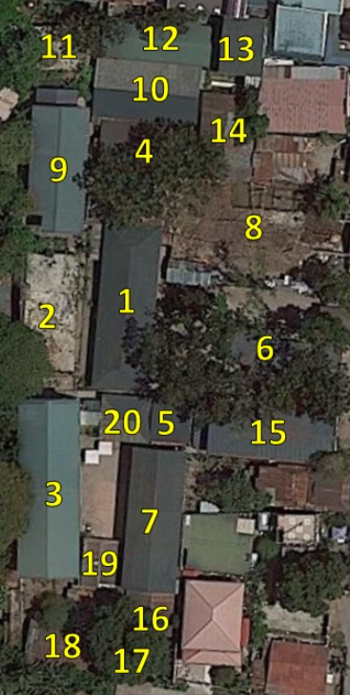
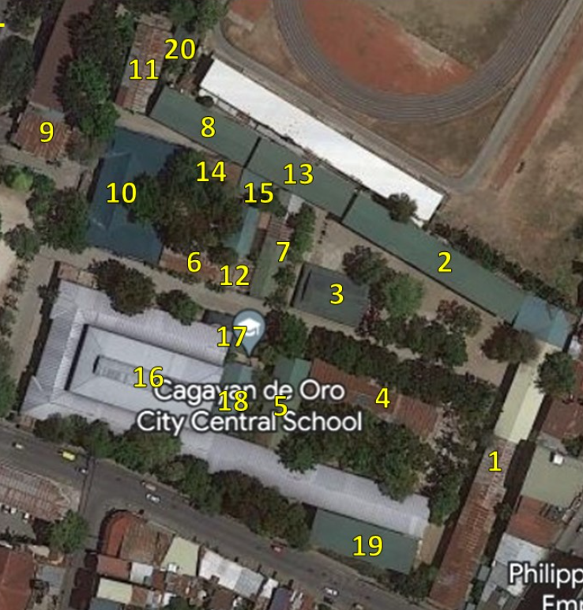
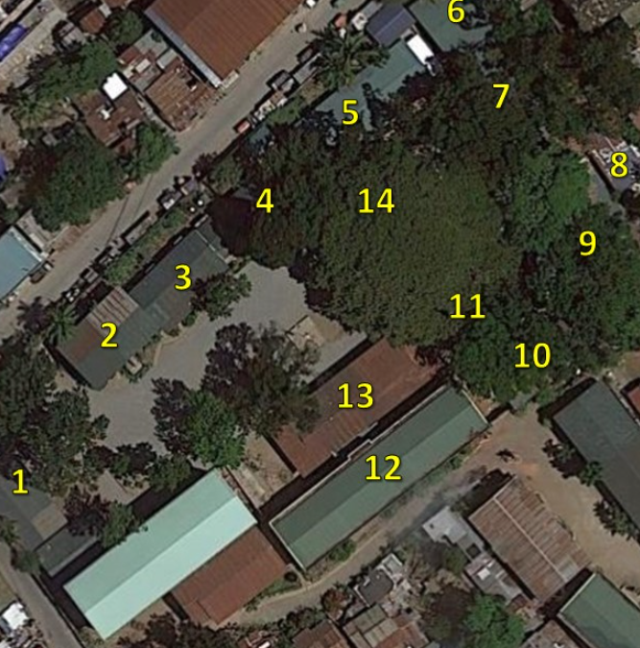

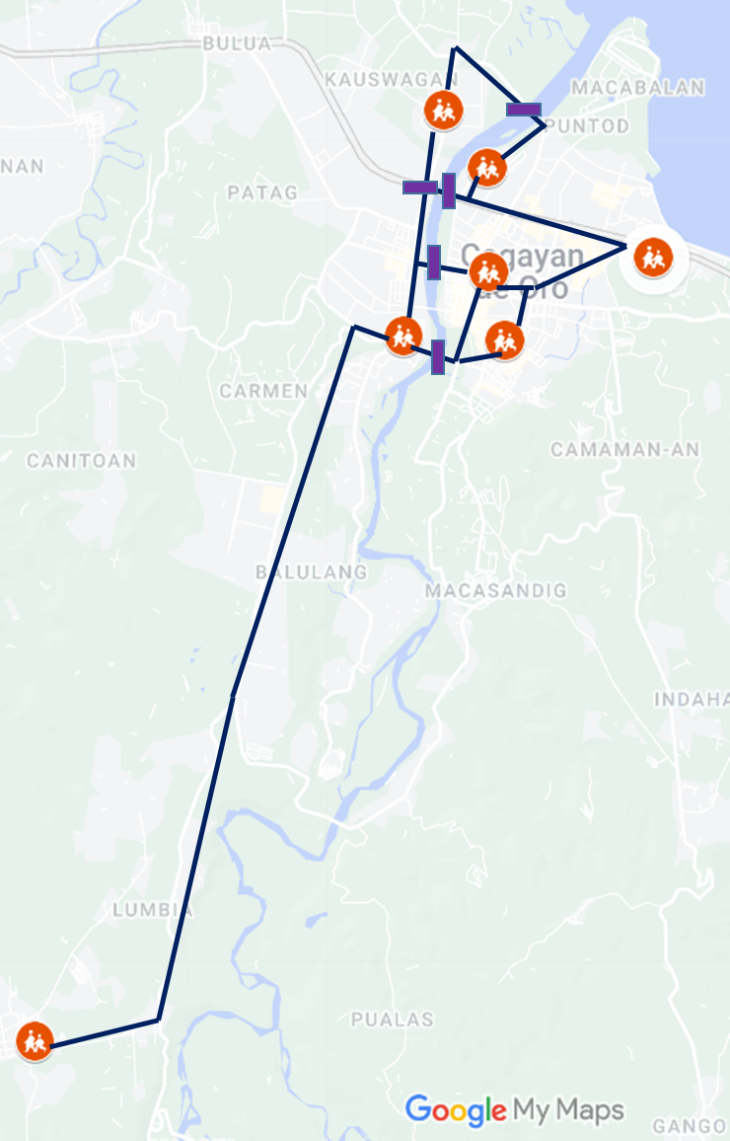

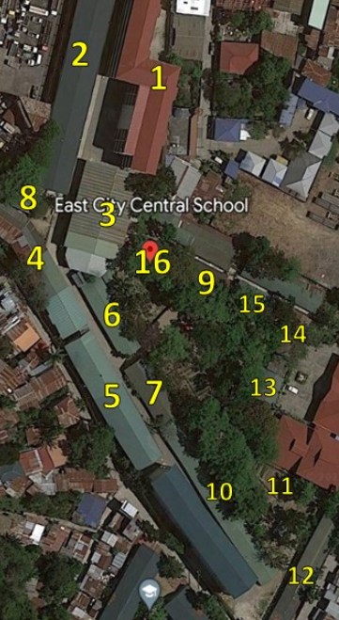
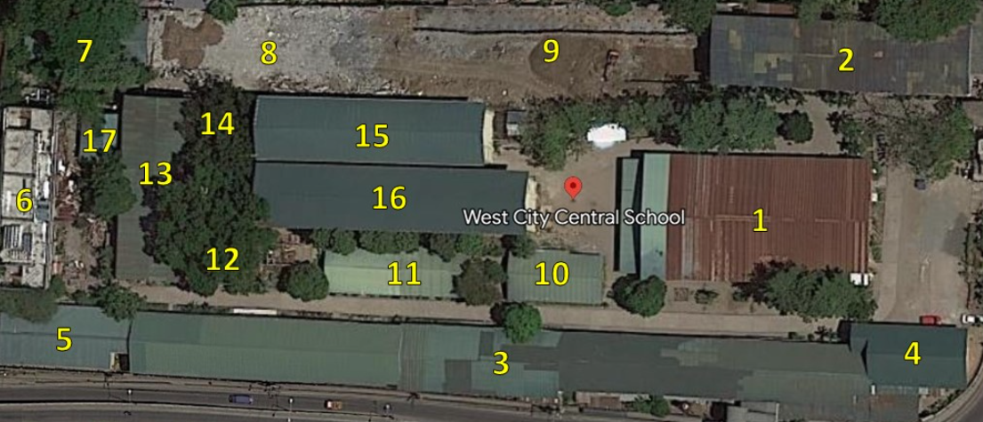
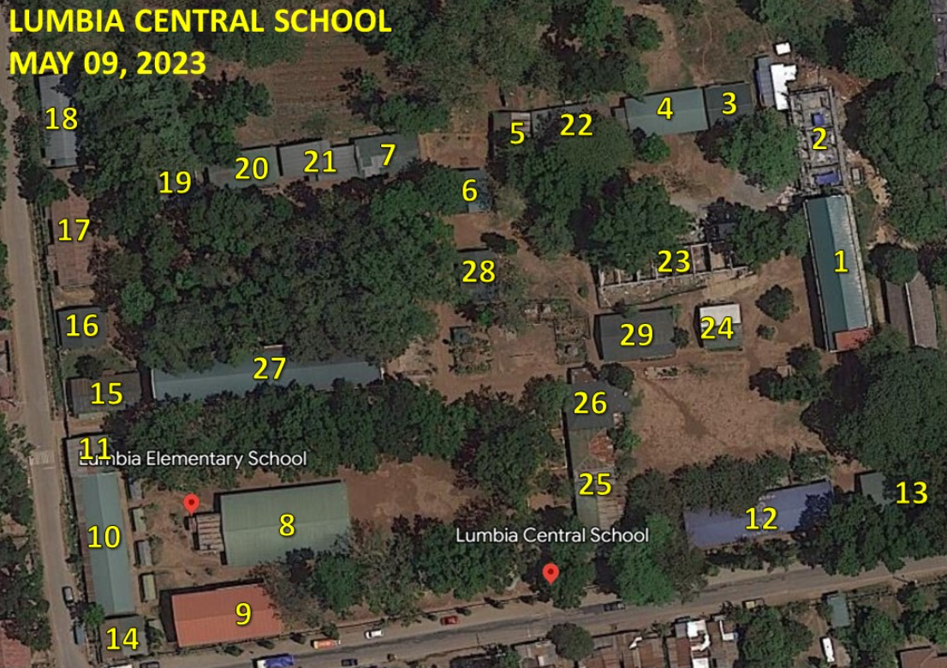
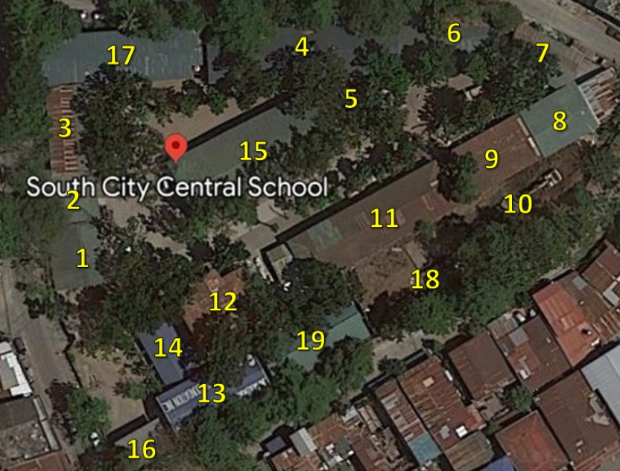
Survey of Schools
Past projects:
1: Kauswagan CS
8
e1
B5: cannot identify in bridge database
10
B1
9
12
B2
2: Consolacion ES
UCL, XU, DLSU
15
11
B3
3: City CS
6: West CCS
13
4: East CCS
14
B4
5: South CCS
7: Lumbria
16

